Slide 1
CHAPTER 11: Hypothesis Testing
Involving Two Sample Means or Proportions
to accompany
Introduction to Business Statistics
seventh edition, by Ronald M. Weiers
Presentation by Priscilla Chaffe-Stengel
Donald N. Stengel
© 2011 Cengage Learning.
All Rights Reserved. May not be scanned, copied, duplicated, or posted to a publicly accessible website, in whole or in part.

Slide 2
Chapter 11 - Learning Objectives
Select and use the appropriate hypothesis test in comparing
  Means of two independent samples
  Means of two dependent samples
  Proportions of two independent samples
  Variances of two independent samples
Construct and interpret the appropriate confidence interval for differences in
  Means of two independent samples
  Means of two dependent samples
  Proportions of two independent samples
© 2011 Cengage Learning.
All Rights Reserved. May not be scanned, copied, or duplicated, or posted to a publicly accessible website, in whole or in part.

Slide 3
Chapter 11 - Key Terms
Independent vs dependent samples
Pooled estimate of the
  common variance
  common standard deviation
  population proportion
Standard error of the estimate for the
  difference of two population means
  difference of two population proportions
Matched, or paired, observations
Average difference
© 2011 Cengage Learning.
All Rights Reserved. May not be scanned, copied, or duplicated, or posted to a publicly accessible website, in whole or in part.

Slide 4
Independent vs Dependent Samples
Independent Samples:
Samples taken from two different populations, where the selection process for one sample is independent of the selection process for the other sample.
Dependent Samples: Samples taken from two populations where either
(1) the element sampled is a member of both populations or (2) the element sampled in the second population is selected because it is similar on all other characteristics, or “matched,” to the element selected from the first population
© 2011 Cengage Learning.
All Rights Reserved. May not be scanned, copied, or duplicated, or posted to a publicly accessible website, in whole or in part.

Slide 5
Examples: Independent versus Dependent Samples
Independent Samples:
  Testing a company’s claim that its peanut butter contains less fat than that produced by a competitor.
Dependent Samples:
  Testing the relative fuel efficiency of 10 trucks that run the same route twice, once with the current air filter installed and once with the new filter.
© 2011 Cengage Learning.
All Rights Reserved. May not be scanned, copied, or duplicated, or posted to a publicly accessible website, in whole or in part.

Slide 6
Identifying the Appropriate Test Statistic
Ask the following questions:
Are the data from measurements (continuous variables) or counts (discrete variables)?
Are the data from independent samples?
Are the population variances approximately equal?
Are the populations approximately normally distributed?
What are the sample sizes?
© 2011 Cengage Learning.
All Rights Reserved. May not be scanned, copied, or duplicated, or posted to a publicly accessible website, in whole or in part.

Slide 7
Test of (µ₁ – µ₂), σ₁ = σ₂, Populations Normal
Test Statistic
  and df = n₁ + n₂ – 2
[
x
–
x
]
–
[
μ
–
μ
]
t
=
1
2
1
2
0
2
⎛
1
1
⎞
s
⎜
+
⎟
p
⎜
n
n
⎟
⎜
1
2
⎟
⎜
⎟
⎜
⎟
⎝
⎠
(
n
–
1
⋅
2
+
⋅
2
)
s
(
n
–
1
)
s
where
s
2
=
1
1
2
2
p
n
+
n
–
2
1
2
© 2011 Cengage Learning.
All Rights Reserved. May not be scanned, copied, or duplicated, or posted to a publicly accessible website, in whole or in part.

Slide 8

Example: Equal-Variances t-Test
Problem 11.2: An educator is considering two different videotapes for use in a half-day session designed to introduce students to the basics of economics. Students have been randomly assigned to two groups, and they all take the same written examination after viewing the videotape. The scores are summarized below. Assuming normal populations with equal standard deviations, does it appear that the two videos could be equally effective? What is the most accurate statement that could be made about the p-value for the test?
Videotape 1: = 77.1, s₁ = 7.8, n₁ = 25
Videotape 2: = 80.0, s₂ = 8.1, n₂ = 25
x
2
© 2011 Cengage Learning.
All Rights Reserved. May not be scanned, copied, or duplicated, or posted to a publicly accessible website, in whole or in part.

Slide 9
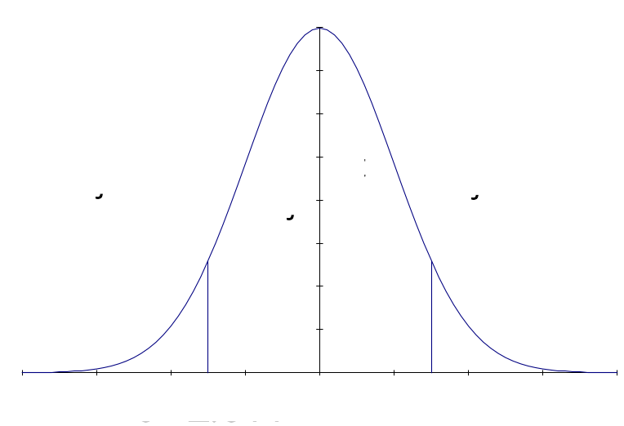
t-Test, Two Independent Means
I. H₀: µ₁ – µ₂ = 0 The two videotapes are equally effective. There is no difference in student performance.
H₁: µ₁ – µ₂ ≠ 0 The two videotapes are not equally effective. There is a difference in student performance.
II. Rejection Region
  α = 0.05
  df = 25 + 25 – 2 = 48
  Reject H₀ if t > 2.011 or t < –2.011
© 2011 Cengage Learning.
All Rights Reserved. May not be scanned, copied, or duplicated, or posted to a publicly accessible website, in whole or in part.

Slide 10
t-Test, Problem 11.2 cont.
III. Test Statistic
24
⋅
(
7
.
8
)
2
+
24
⋅
(
8
.
1
)
2
1460
.
16
+
1564
.
64
s
2
=
=
=
63
.
225
p
+
25
25
–
2
48
x
–
x
77
.
1
–
80
.
0
t
=
1
2
=
=
–
1
.
289
⎛
⎞
⎛
1
+
1
⎞
⎜
1
1
⎟
63
.
225
⎜
⎟
s
2
⎜
+
⎟
⎜
⎟
p
⎜
⎟
⎜
25
25
⎟
⎜
n
n
⎟
⎝
⎠
⎜
1
2
⎟
⎜
⎟
⎝
⎠
© 2011 Cengage Learning.
All Rights Reserved. May not be scanned, copied, or duplicated, or posted to a publicly accessible website, in whole or in part.

Slide 11
t-Test, Problem 11.2 cont.
IV. Conclusion:
Since the test statistic of t = – 1.289 falls between the critical bounds of t = ± 2.011, we do not reject the null hypothesis with at least 95% confidence.
V. Implications:
There is not enough evidence for us to conclude that one videotape training session is more effective than the other.
p-value:
Using Microsoft Excel, type in a cell: =TDIST(1.289,48,2)
The answer: p-value = 0.203576
© 2011 Cengage Learning.
All Rights Reserved. May not be scanned, copied, or duplicated, or posted to a publicly accessible website, in whole or in part.

Slide 12
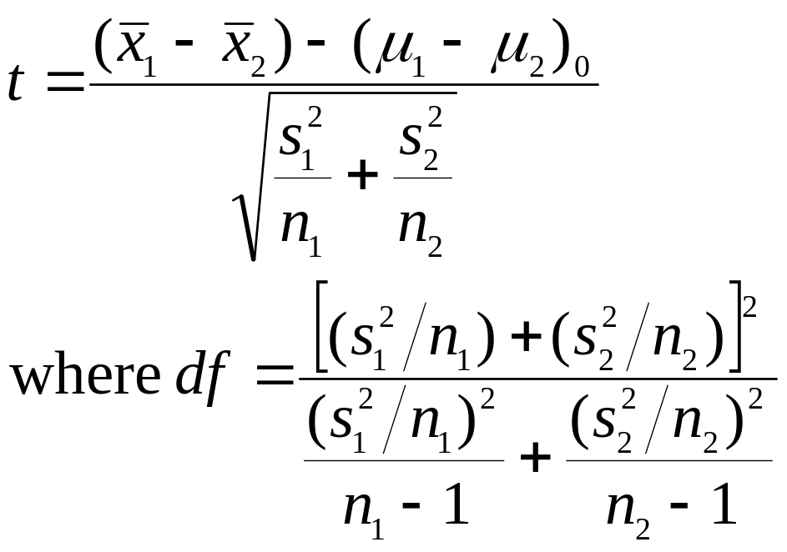
Test of (µ₁ – µ₂), Unequal Variances, Independent Samples
Test Statistic
© 2011 Cengage Learning.
All Rights Reserved. May not be scanned, copied, or duplicated, or posted to a publicly accessible website, in whole or in part.

Slide 13
Example, Unequal-Variances t-Test, Independent Samples
Problem 11.29: It has been reported that the average visitor from Japan spent $3120 during a trip to the United States, while the average for a visitor from the United Kingdom was $2654. Using the data from the next slide, use the 0.05 level in examining whether the sample mean for Japanese visitors is significantly higher than that for visitors from the United Kingdom. Identify and interpret the p-value for the test.
© 2011 Cengage Learning.
All Rights Reserved. May not be scanned, copied, or duplicated, or posted to a publicly accessible website, in whole or in part.

Slide 14
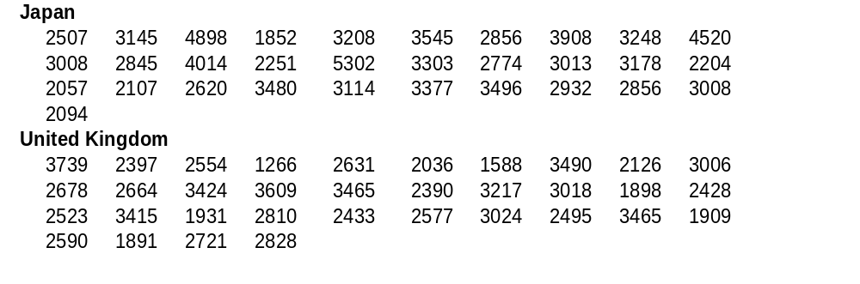
t-Test, Problem 11.29, cont.
Using the following data, conduct an unequal-variances t-test in Excel:
© 2011 Cengage Learning.
All Rights Reserved. May not be scanned, copied, or duplicated, or posted to a publicly accessible website, in whole or in part.

Slide 15
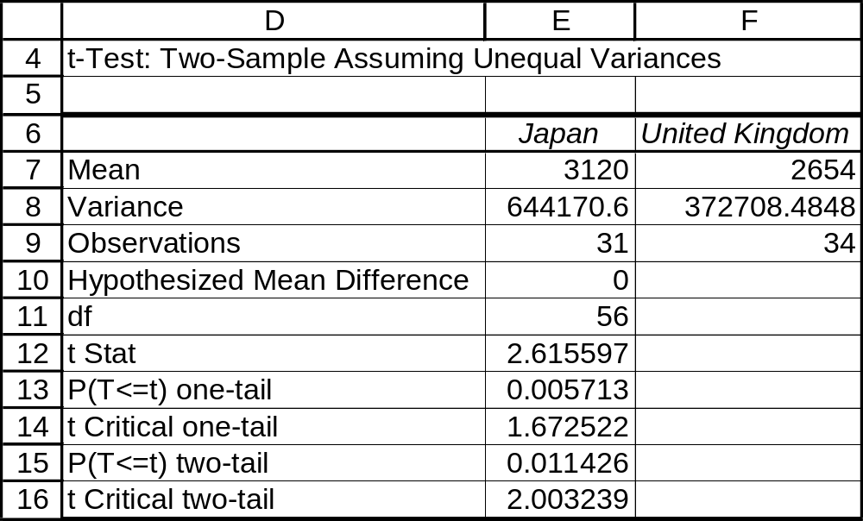
t-Test, Problem 11.29, cont.
Excel output, Problem 11.29:
Note that the degrees of freedom for this t-test is 56, not 63.
The test statistic
The p-value, one tail
The critical bound, one tail
© 2011 Cengage Learning.
All Rights Reserved. May not be scanned, copied, or duplicated, or posted to a publicly accessible website, in whole or in part.

Slide 16
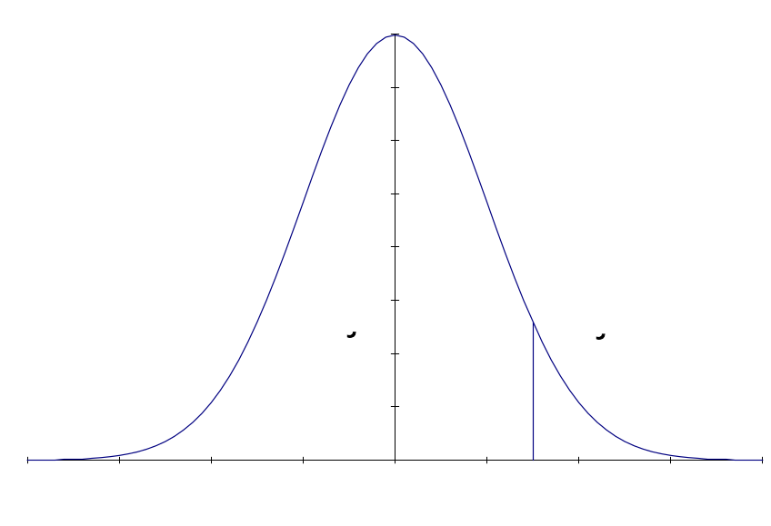
t-Test, Problem 11.29, cont.
I. H₀: µ₁ – µ₂ ≤ 0 The average expenditure for a visitor from Japan is not significantly higher than the average for a visitor from the United Kingdom.
H₁: µ₁ – µ₂ > 0 The average expenditure for a visitor from Japan is significantly higher than the average for a visitor from the United Kingdom.
II. Rejection Region
  α = 0.05
  df = 56
  Reject H₀ if t > 2.003.
t = 2.003
© 2011 Cengage Learning.
All Rights Reserved. May not be scanned, copied, or duplicated, or posted to a publicly accessible website, in whole or in part.

Slide 17
t-Test, Problem 11.29 cont.
III. Test Statistic
t = 2.6156
IV. Conclusion:
Since the test statistic of t = 2.6156 falls above the critical bound of t = 2.003, we do reject the null hypothesis with at least 95% confidence.
V. Implications:
There is enough evidence for us to conclude that average expenditure for a visitor from Japan is significantly higher than the average for a visitor from the United Kingdom.
p-value = 0.0057
© 2011 Cengage Learning.
All Rights Reserved. May not be scanned, copied, or duplicated, or posted to a publicly accessible website, in whole or in part.

Slide 18
Test of Independent Samples
(µ₁ – µ₂), σ₁ ≠σ₂, n₁ and n₂ ≥ 30
Test Statistic
  with s₁² and s₂² as estimates for σ₁² and σ₂²
[
x
–
x
]
–
[
μ
–
μ
]
z
=
1
2
1
2
0
s
2
s
2
1
+
2
n
n
1
2
© 2011 Cengage Learning.
All Rights Reserved. May not be scanned, copied, or duplicated, or posted to a publicly accessible website, in whole or in part.

Slide 19

Test of Dependent Samples
(µ₁ – µ₂) = µ_{d}
Test Statistic
  where d = (x₁ – x₂)
  = Σd/n, the average difference
n = the number of pairs of observations
s_{d} = the standard deviation of d
df = n – 1
t
=
d
s
d
n
© 2011 Cengage Learning.
All Rights Reserved. May not be scanned, copied, or duplicated, or posted to a publicly accessible website, in whole or in part.

Slide 20
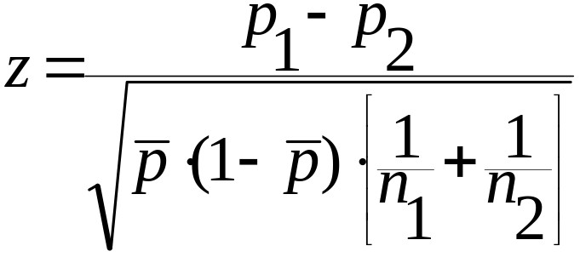
Test of (π₁ – π₂), where n₁p₁≥5, n₁(1–p₁)≥5, n₂p₂≥5, and n₂ (1–p₂ )≥5
Test Statistic
  where p₁ = observed proportion, sample 1
  p₂ = observed proportion, sample 2
  n₁ = sample size, sample 1
  n₂ = sample size , sample 2
n
p
+
n
p
p
=
1
1
2
2
n
+
n
© 2011 Cengage Learning.
All Rights Reserved. May not be scanned, copied, or duplicated, or posted to a publicly accessible website, in whole or in part.
1
2

Slide 21
Testing for Equal Variances
Pooled-variances t-test assumes the two population variances are equal.
The F-test can be used to test that assumption.
The F-distribution is the sampling distribution of s₁²/s₂² that would result if two samples were repeatedly drawn from a single normally distributed population.
© 2011 Cengage Learning.
All Rights Reserved. May not be scanned, copied, or duplicated, or posted to a publicly accessible website, in whole or in part.

Slide 22
Test of σ₁² = σ₂²
If σ₁² = σ₂² , then σ₁²/σ₂² = 1. So the hypotheses can be worded either way.
Test Statistic: whichever is larger
The critical value of the F will be F(α/2, ν₁, ν₂)
  where α = the specified level of significance
  ν₁ = (n – 1), where n is the size of the sample with the larger variance
  ν₂ = (n – 1), where n is the size of the sample with the smaller variance
s
2
s
2
F
=
1
or
2
s
2
s
2
2
1
© 2011 Cengage Learning.
All Rights Reserved. May not be scanned, copied, or duplicated, or posted to a publicly accessible website, in whole or in part.

Slide 23
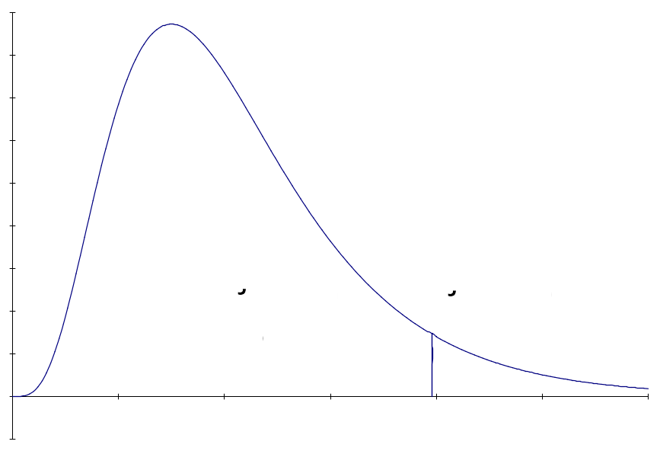
Testing for Equal Variances -
An Example
Returning to Problem 11.2, let us test with 95% confidence whether it was reasonable for us to assume that the two population variances were approximately equal.
I. H₀: σ₂²/σ₁² = 1
H₁: σ₂²/σ₁² ≠ 1
II. Rejection Region
α/2 = 0.025
numerator df = 24
denominator df = 24
If F > 2.27, reject H₀, meaning it was not reasonable for us to assume the population variances were approximately equal.
© 2011 Cengage Learning.
All Rights Reserved. May not be scanned, copied, or duplicated, or posted to a publicly accessible website, in whole or in part.

Slide 24
Testing for Equal Variances -
An Example, cont.
III. Test Statistic
IV. Conclusion
Since the test statistic of F = 1.078 falls below the critical value of F = 2.27, we do not reject H₀ with at most 5% error.
V. Implications
There is not enough evidence to support a conclusion that the two populations have different variances. The pooled variances t-test can be used in analyzing these data. It was reasonable for us to use the pooled variances t-test in analyzing differences between the two population means.
s
2
2
F
=
2
=
8
.
1
=
1
.
0784
s
2
7
.
8
2
1
© 2011 Cengage Learning.
All Rights Reserved. May not be scanned, copied, or duplicated, or posted to a publicly accessible website, in whole or in part.

Slide 25
Confidence Interval for (µ₁ – µ₂)
The (1 – α)% confidence interval for the difference in two means:
  Equal-variances t-interval
  Unequal-variances t-interval
⎛
⎞
⎜
1
1
⎟
±
⋅
2
⎜
+
⎟
(
x
–
x
)
t
s
⎜
⎟
1
2
α
p
⎜
⎟
2
⎜
n
n
⎟
⎜
1
2
⎟
⎜
⎟
⎝
⎠
s
2
s
2
(
x
–
x
)
±
t
⋅
1
+
2
1
2
α
2
n
n
1
2
© 2011 Cengage Learning.
All Rights Reserved. May not be scanned, copied, or duplicated, or posted to a publicly accessible website, in whole or in part.

Slide 26
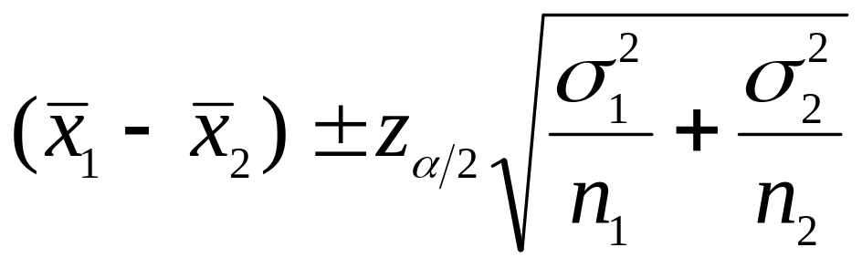
Confidence Interval for (µ₁ – µ₂)
The (1 – α)% confidence interval for the difference in two means:
  Known-variances z-interval
© 2011 Cengage Learning.
All Rights Reserved. May not be scanned, copied, or duplicated, or posted to a publicly accessible website, in whole or in part.

Slide 27
Confidence Interval for (π₁ – π₂)
The (1 – α)% confidence interval for the difference in two proportions:
  when sample sizes are sufficiently large.
p
(
1
–
p
)
p
(
1
–
p
)
(
p
–
p
)
±
z
⋅
1
1
+
2
2
1
2
α
2
n
n
1
2
© 2011 Cengage Learning.
All Rights Reserved. May not be scanned, copied, or duplicated, or posted to a publicly accessible website, in whole or in part.

